Slide 1

Dr. Babasaheb Ambedkar Technological University, Lonere
Mini-Project Presentation
Title- Railway station safety system using Arduino
Name-
Siddhesh Bhanudas Dangade (2130331372501)
Shruti Ramakant Biradar (2130331372535)

Slide 2


Presentation on:
Railway station safety system using Arduino
Presented by- Siddhesh Dangade & Shruti Biradar

Slide 3
CONTENT
Introduction
Components
Block Diagram
Circuit diagram
Arduino Uno
Ultrasonic Sensor
Servo Motor
Working
Advantages
Application
Conclusion
References

Slide 4
Project is about, railway station platform safety and accident prevention. By engaging a rigid bridge like structure, we can effectively increase safety and reduce accidents. It will avoid crowd falling between track and train.
01
Introduction

Slide 5
Project is about, railway station platform safety and accident prevention. By engaging a rigid bridge like structure, we can effectively increase safety and reduce accidents. It will avoid crowd falling between track and train.
About Project

Slide 6
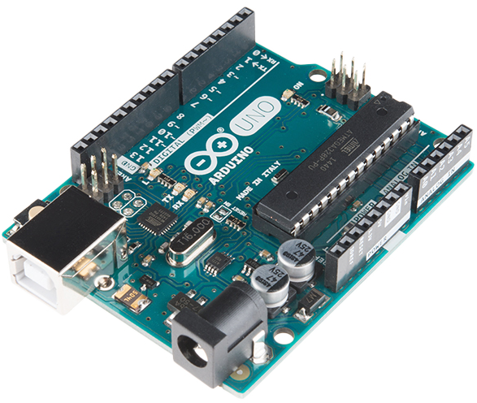
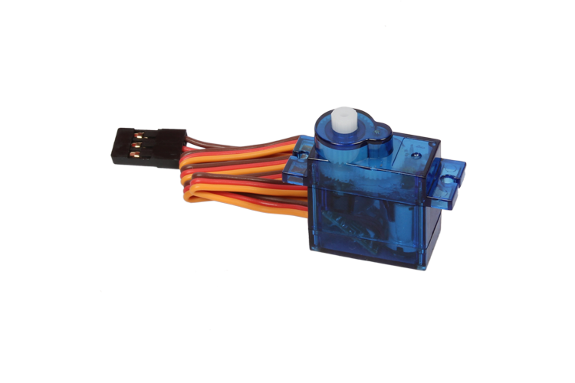
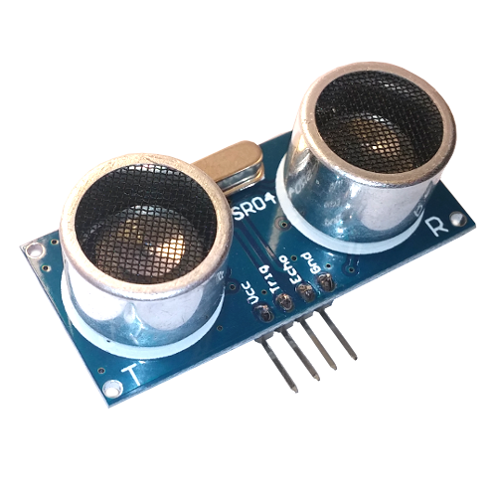
02
Components

Slide 7
Components
Ultrasonic Sensor
Servo Motor
Arduino UNO

Slide 8

03
BLOCK DIAGRAM
BLOCK DIAGRAM
ULTRASONIC
SENSOR
ARDUINO
LED
SERVO MOTOR

Slide 9
BLOCK DIAGRAM
ULTRASONIC
SENSOR
ARDUINO
LED
SERVO MOTOR

Slide 10

04
CIRCUIT DIAGRAM

Slide 11
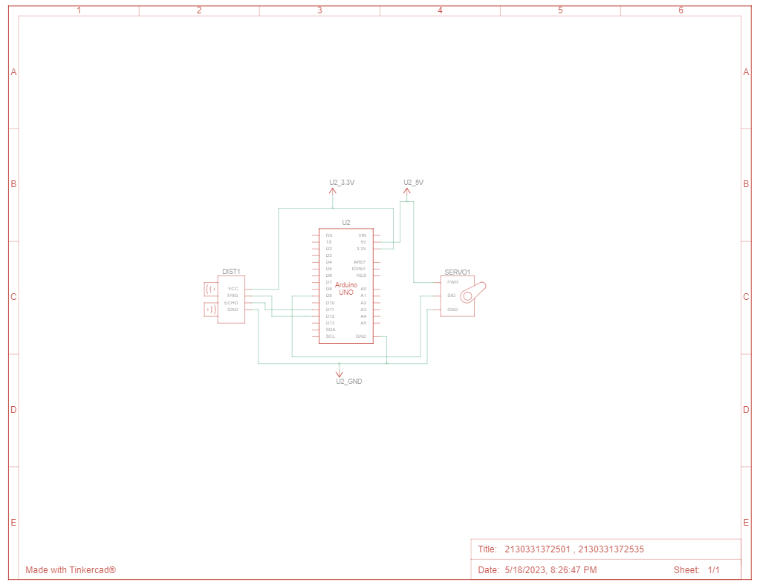
Circuit Diagram
Here is circuit and component connection diagram

Slide 12

05
ARDUINO UNO

Slide 13
About Arduino uno
Arduino Uno is a microcontroller board based on the ATmega328P. It has 14 digital input/output pins (of which 6 can be used as PWM outputs), 6 analog inputs, a 16 MHz ceramic resonator, a USB connection, a power jack, an ICSP header and a reset button. It contains everything needed to support the microcontroller.

Slide 14
06
Ultrasonic sensor

Slide 15
Ultrasonic sensor
An ultrasonic sensor is an instrument that measures the distance to an object using ultrasonic sound waves. High-frequency sound waves reflect from boundaries to produce distinct echo patterns. Ultrasonic sensors work by sending out a sound wave at a frequency above the range of human hearing. The transducer of the sensor acts as a microphone to receive and send the ultrasonic sound.

Slide 16
07
Servo motor

Slide 17
A servo motor is an electromechanical device that is commonly used in various applications such as robotics, automation, and control systems. It is designed to provide precise control over angular position, speed, and acceleration.

Slide 18
08
Working
Working
04(A)
If distance is less than programmed value then, Servo motor is engaged
If yes
01
02
03
Train Arrives
Signal send
Distance is verified by arduino.
Checking
Train detected by ultrasonic sensor.
Information about object and its distance from platform is send to arduino
04(B)
If the distance is not less and more than coded value then servo motor remains closed
If No

Slide 19
Working
04(A)
If yes
01
02
03
If distance is less than programmed value then, Servo motor is engaged
Train Arrives
Signal send
Checking
Train detected by ultrasonic sensor.
Information about object and its distance from platform is send to arduino
Distance is verified by arduino.
04(B)
If No
If the distance is not less and more than coded value then servo motor remains closed

Slide 20
09
Advantage

Slide 21

Advantage
This project has numerous future scope, mainly revolve around safety and accident prevention. This project is very easy to install, not much costly compared to other safety solutions, and responsive too.

Slide 22
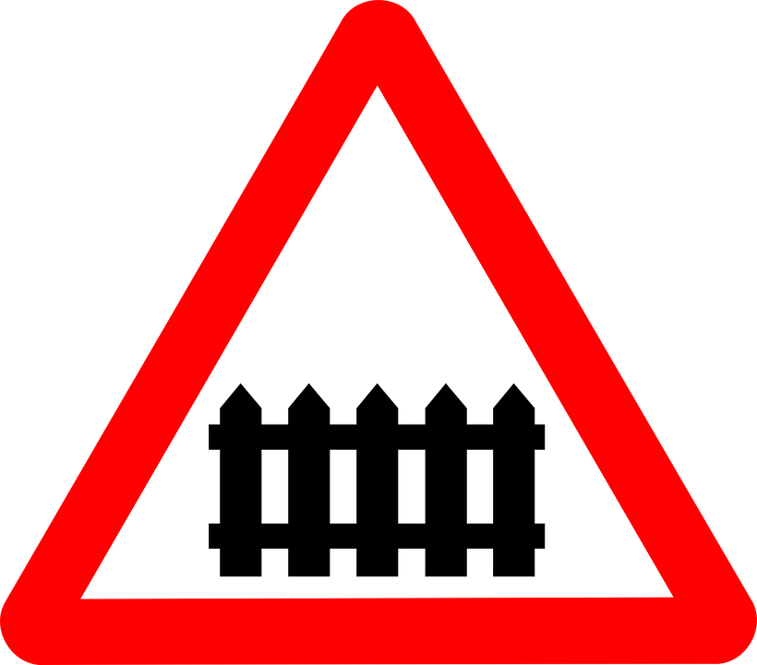

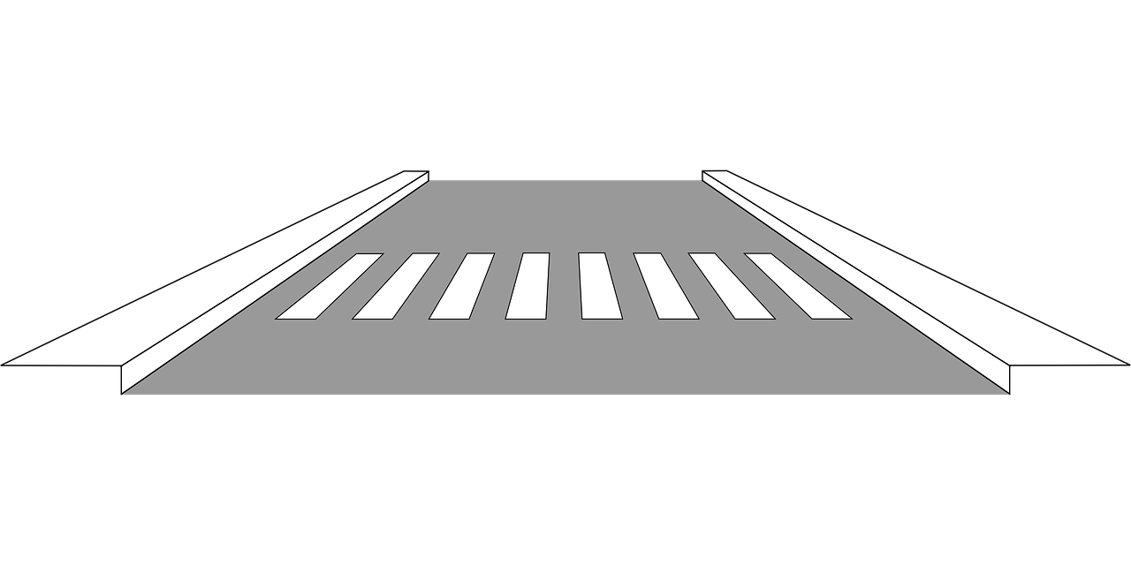
10
Application

Slide 23
Here, are some applications, 1) Railway crossing 2) Railway platform 3) Road crossing

Slide 24
Conclusion

Slide 25
This project can mainly be implimanted at railway station as they are densely crowded. A simple yet efficient safety system can enchance safety. extremely thankful to Eletronics and telecommunication Dept. of D.B.A.T University for providing us oppurnity to present innovative ideas
Conclusion

Slide 26
[1] Code of practice for train lighting maintenance on prevention of Crack detection system for railway track using Ultrasonic and PIR [2] Sensor, Prof. P.Navaraja, Volume 05, 2014. [3] Dhiraj Sinha, Farhan Feroz. “Obstacle Detection on Railway Tracks Using Vibration Sensors and Signal Filtering Using [4] Bayesian Analysis,” IEEE Sensors Journal Vol. 16, Issue. 3, Feb.1, 2006 [5] Krishna, ShashiYadav and Nidhi, “Automatic Railway Gate
References

